Slide 1
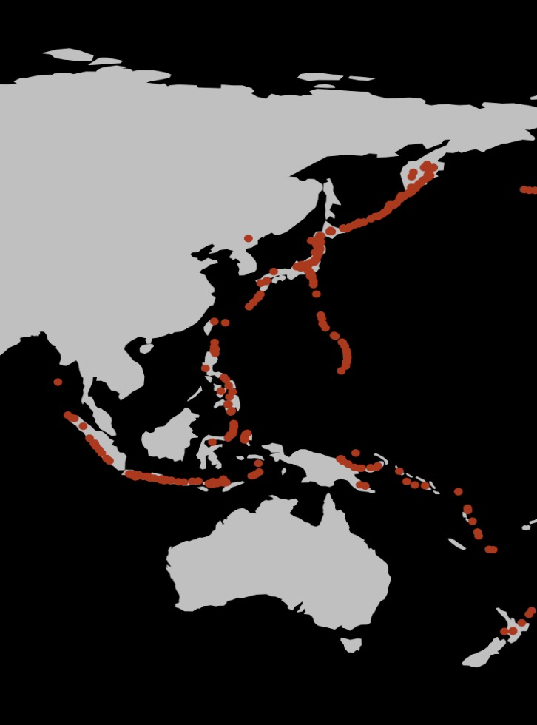
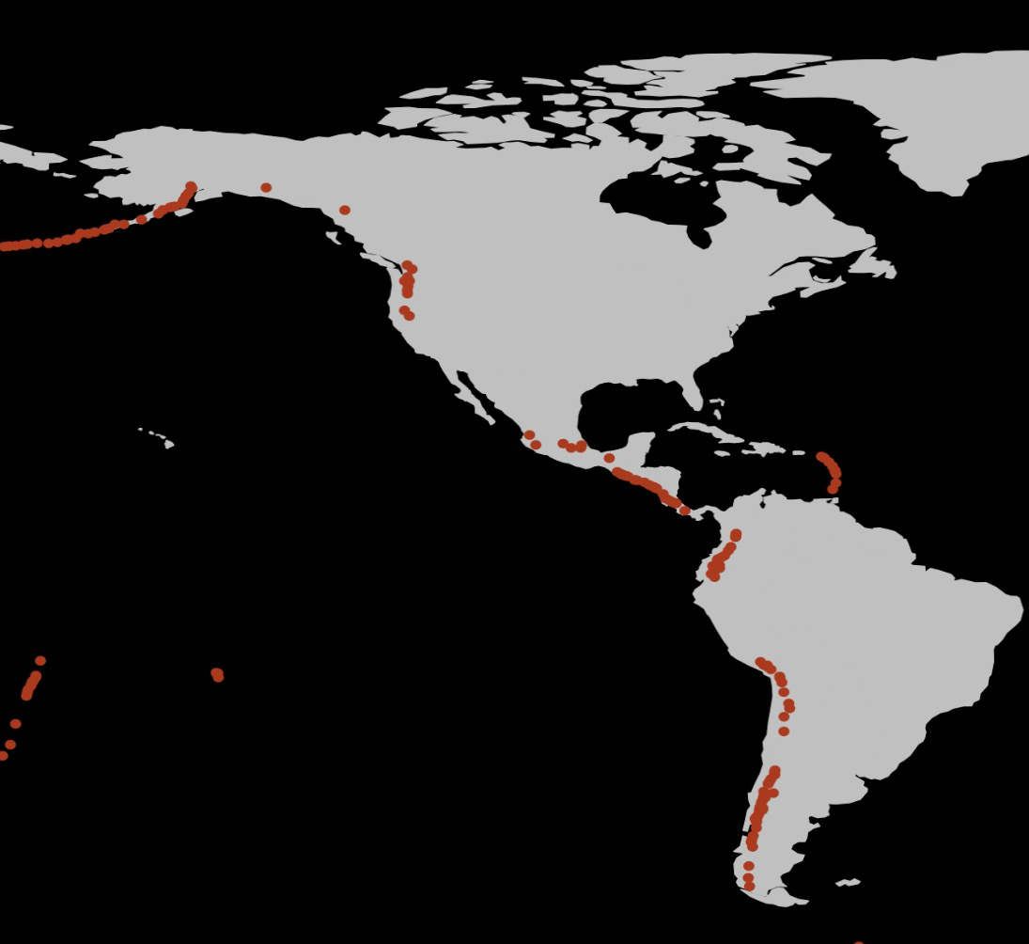
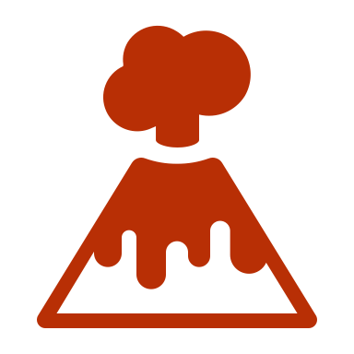
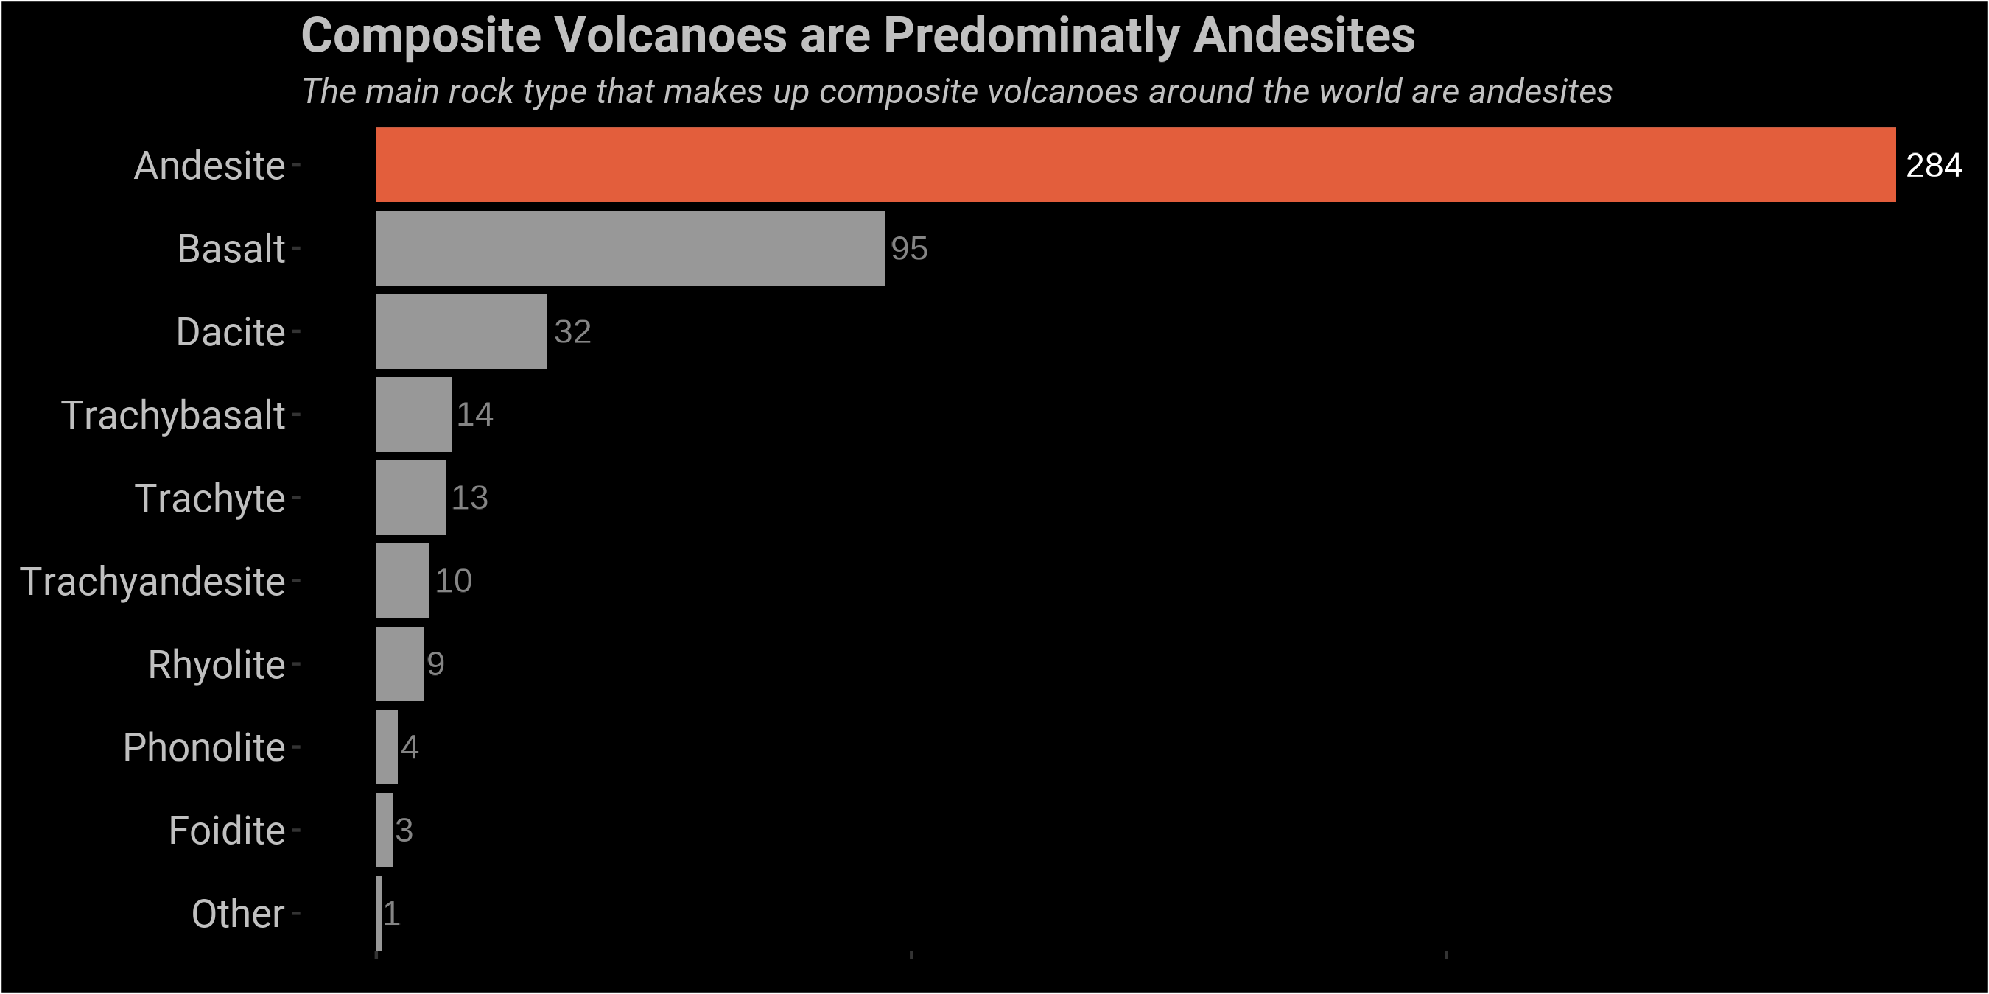

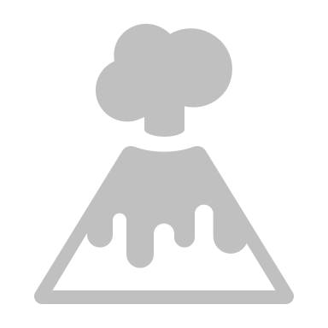
What is a Composite Volcano?
Composite volcanoes are large volcanoes present around the Ring of Fire, an area that borders the Pacific Ocean with high levels of volcanic activity. What causes these volcanoes to arise here, and how can we see this in the rock record?
A specific type of volcano, a composite or stratovolcano dominates the Ring of Fire
Composite Volcano
Examples of famous composite volcanoes include Mount Ranier in Washington and Mount Fuji in Japan. But what do these volcanoes have in common?
Rift Zone
4%
Intraplate 7%
Most composite volcanoes are andesites, which form in a specific type of tectonic setting called a subduction zone
Subduction zones occur around the Pacific Ocean, where more dense the Pacific Oceanic Plate moves under the less dense continental plates that surround it
This process causes melting of both plates, which creates magma that rises to the surface, forming the volcanoes known as the Ring of Fire
Subduction Zone 89%

